Slide 1

AI Driven Digital Transformation: How Machine Learning is Shaping E-Commerce

Slide 2

Overview of Machine Learning and how it works in E-Commerce

Slide 3

What is ML actually -
Machine learning, a subset of artificial intelligence (AI), involves the development of algorithms that allow computers to learn from and make decisions based on data without explicit programming.
In IBM’s viewpoint - Machine learning (ML) is ….. 1) a branch of computer science
2) focuses on the using data and algorithms to enable AI
3) imitate the way that humans learn,
4) gradually improving its accuracy.

Slide 4
How it is exercised in e-commerce
In e-commerce, this technology is reshaping the way businesses operate, changing the way how customer experience, and enhancing future business prospects. There are many-more aspects/use cases by which machine learning is being implemented in e-commerce. Some interesting points are being depicted hereby –

Slide 5
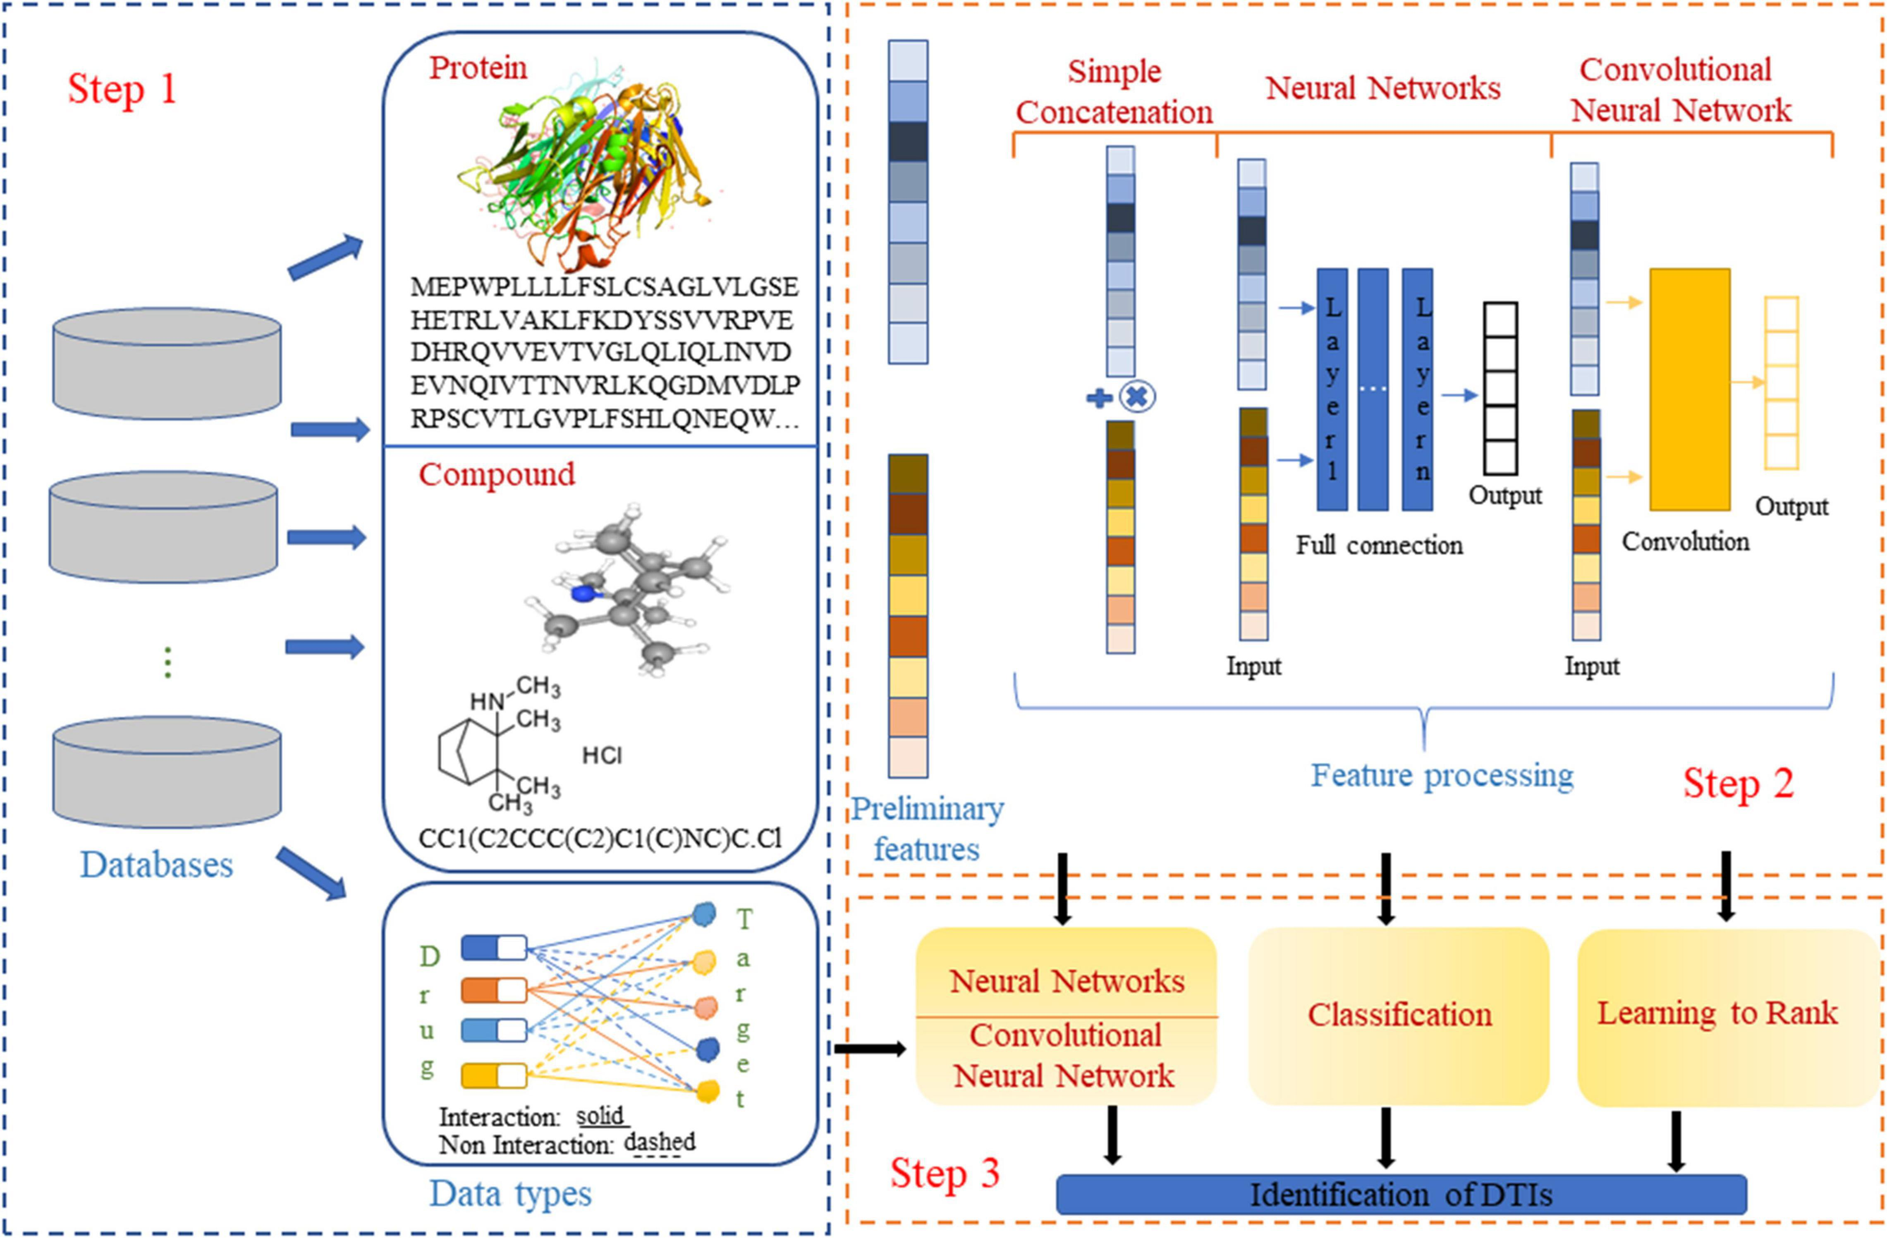
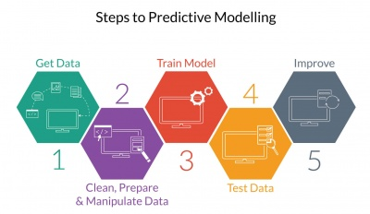

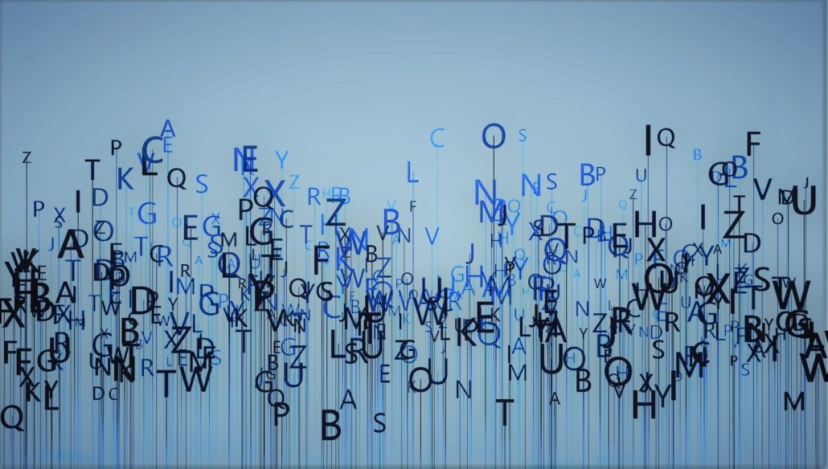
Data analysis
Predictive analysis
Classification algorithms
Natural language processing
source: https://www.researchgate.net/publication/376324520_Recent_Machine-Learning-Driven_Developments_in_E-Commerce_Current_Challenges_and_Future_Perspectives?enrichId=rgreq-827adbbba9ab58056dfbcc11bdbba5e0-XXX&enrichSource=Y292ZXJQYWdlOzM3NjMyNDUyMDtBUzoxMTQzMTI4MTI1MDYxMDMyNUAxNzE3OTM2NDE1MzUx&el=1_x_2&_esc=publicationCoverPdf
ThePhoto by PhotoAuthor is licensed under CCYYSA.

Slide 6
Benefits of Utilizing Machine Learning in E-Commerce

Slide 7



Significant applications of Machine Learning for E-Commerce:
Inventory management
Trend Analysis
Churn Prediction
Source: Iqbal, M. Machine learning applications in e-commerce. Organization, Business and Management,65. 2022
Source: Appinventive. How Machine Learning is Shaping eCommerce-10 Benefits, Use Cases, Best Practices. 2024. [Online]: https://appinventiv.com/blog/machine-learning-in-ecommerce/

Slide 8

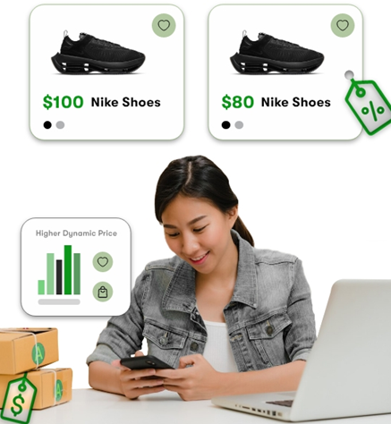
Significant applications of Machine Learning for E-Commerce:
Fraud Detection
Efficiencies in Operations
Dynamic Pricing
Source: Iqbal, M. Machine learning applications in e-commerce.Organization, Business and Management,65. 2022
Source: Appinventive. How Machine Learning is Shaping eCommerce-10 Benefits, Use Cases, Best Practices. 2024. [Online]: https://appinventiv.com/blog/machine-learning-in-ecommerce/

Slide 9

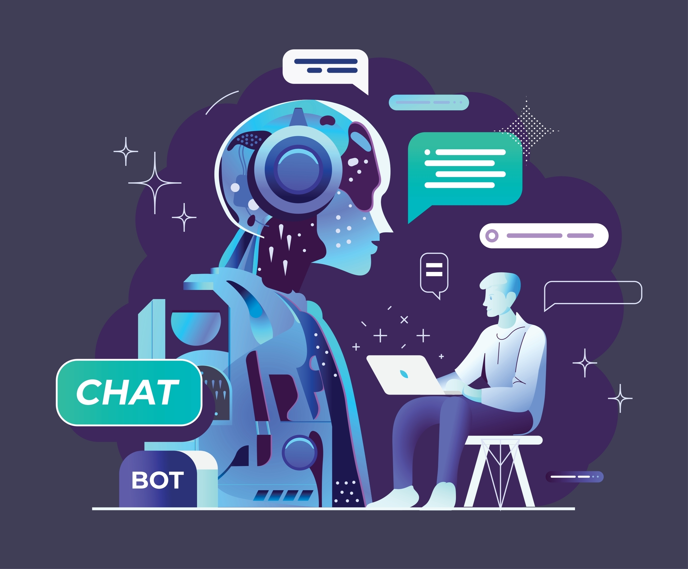

Significant applications of Machine Learning for E-Commerce:
Customer Segmentation
Product Recommendation
Improved Customer Service
Source: Omnisend, 11 ways to use Machine Learning in Ecommerce. 2022. [Online]: https://www.omnisend.com/blog/machine-learning/
Source: Appinventive, How Machine Learning is Shaping eCommerce-10 Benefits, Use Cases, Best Practices.2024. [Online]: https://appinventiv.com/blog/machine-learning-in-ecommerce/

Slide 10
Best Practices for Implementing Machine Learning in E-Commerce

Slide 11
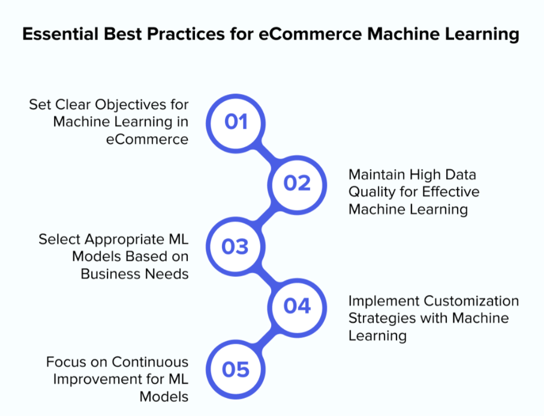
Set Clear Objectives
Set specific goals, such as increasing sales or optimizing processes.
Use measurable KPIs to track the impact of ML models
Source: McKinsey & Company, "The AI Frontier: How to Scale AI in Business", 2021.
Source Link: https://www.mckinsey.com/
.

Slide 12

Maintain high Quality Data
Use accurate and high-quality customer data for ML models.
Ensure data collection complies with privacy regulations.
Source: PwC, "Consumer Intelligence Series: Protect.me", 2018.
Source Link: https://www.pwc.com/gx/en.html

Slide 13
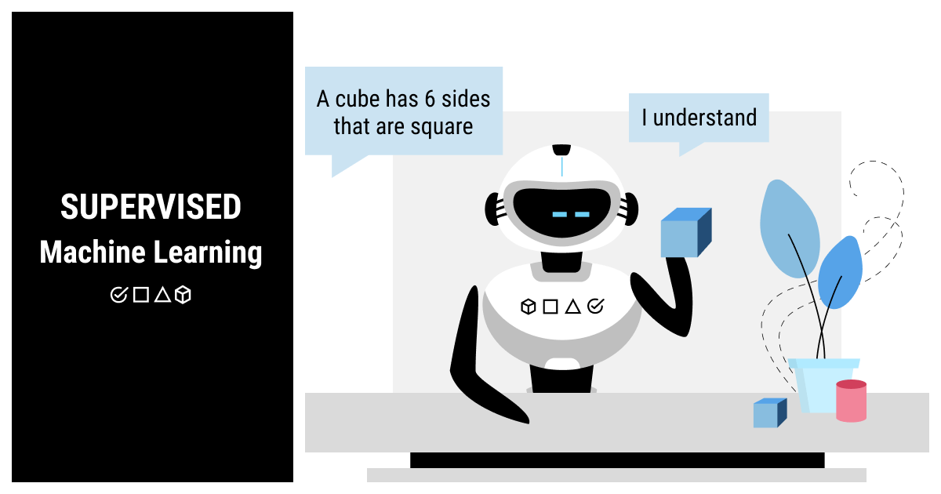
Select Appropriate ML Models
Identify business objectives and specific problems to solve (e.g., customer segmentation, demand forecasting).
Evaluate different types of ML models (e.g., classification, clustering, regression) based on the problem.
Choose models that balance accuracy with computational efficiency.
Source: Gartner, "How to Choose the Right Machine Learning Model for Your Business Use Case", 2020.
Source Link: https://www.gartner.com/en

Slide 14
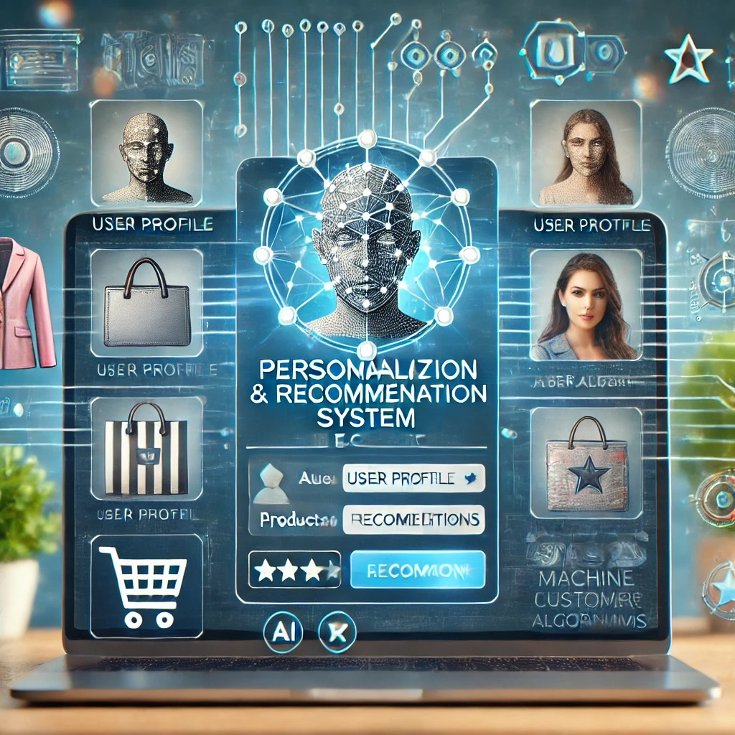
Implement Customized Strategy
Implement collaborative and content-based filtering.
Use deep learning for personalized recommendations and pricing.
Source: McKinsey & Company, "Personalizing the Customer Experience: Driving Growth in Retail", 2022.
Source Link: https://www.mckinsey.com/

Slide 15

Continuous Improvement for ML Models
Retrain models with new data to keep up with evolving trends.
Ensure that feedback loops help models improve continuously.
Source: Boston Consulting Group (BCG), "Reshaping Business with Artificial Intelligence", 2021.
Link: https://www.bcg.com/

Slide 16
Real-Life Applications

Slide 17
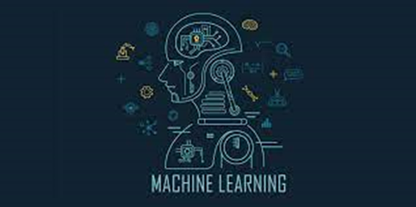


How machine learning is revolutionizing E-Commerce.
Source: https://appinventiv.com/blog/machine-learning-in-ecommerce/

Slide 18
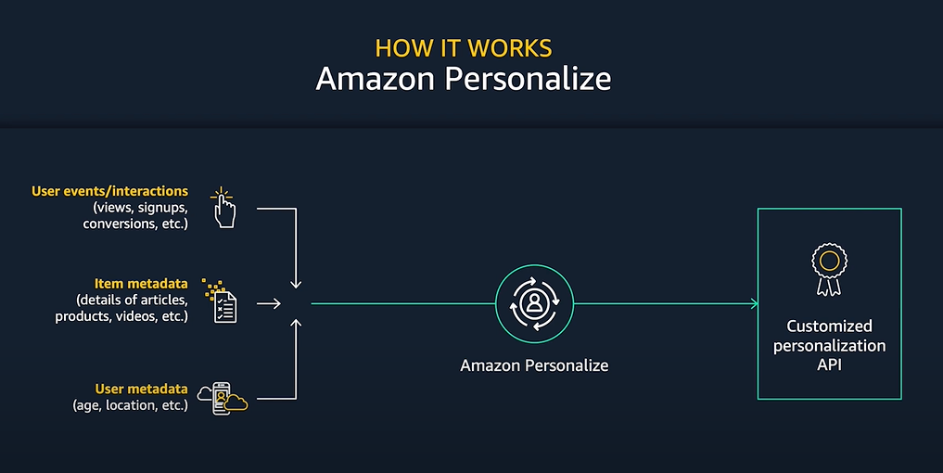
Amazon Personalize-Based Recommendation Engine
Power of AWS's infrastructure + Machine learning capabilities
Delivering personalized recommendations based on users' past interactions
Each user receives recommendations
tailored specifically to their preferences.
Source: https://aws.amazon.com/marketplace/pp/prodview-dmckfctu2grog

Slide 19

Amazon Personalize-Based Recommendation Engine
ROI Methodology:
Improved User Engagement
User Attraction
Extended User Time on Platform
Increased Ad Revenue
Heightened User Satisfaction
Increased User Retention
Enhanced User Experience
Higher Subscription Rates
Source: https://aws.amazon.com/marketplace/pp/prodview-dmckfctu2grog

Slide 20
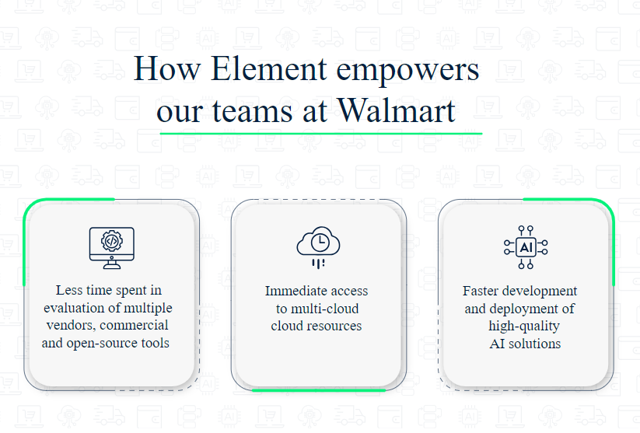
Walmart’s Inventory Management Optimization
Walmart's Machine Learning Platform: Element
Revolutionized platform capabilities.
Simplified the adoption of ML at scale for data scientists and ML engineers throughout the AI solution lifecycle.
Evolved into a highly capable ML system deployed across multiple clouds, utilizing thousands of CPU cores and GPUs.
Source: https://tech.walmart.com/content/walmart-global-tech/en_us/blog/post/walmarts-element-a-machine-learning-platform-like-no-other.html

Slide 21
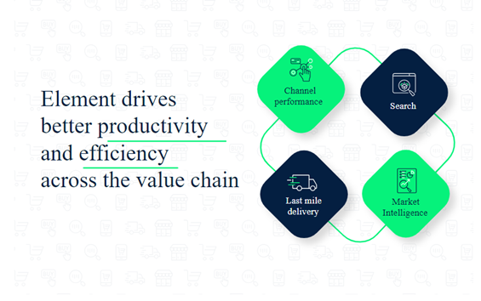
Walmart’s Inventory Management Optimization
Walmart's Element Platform powers several key business operations:
Channel Performance
Search Optimization
Market Intelligence
Last Mile Delivery
Source: https://tech.walmart.com/content/walmart-global-tech/en_us/blog/post/walmarts-element-a-machine-learning-platform-like-no-other.html

Slide 22
The Challenges of Machine Learning in E-Commerce

Slide 23
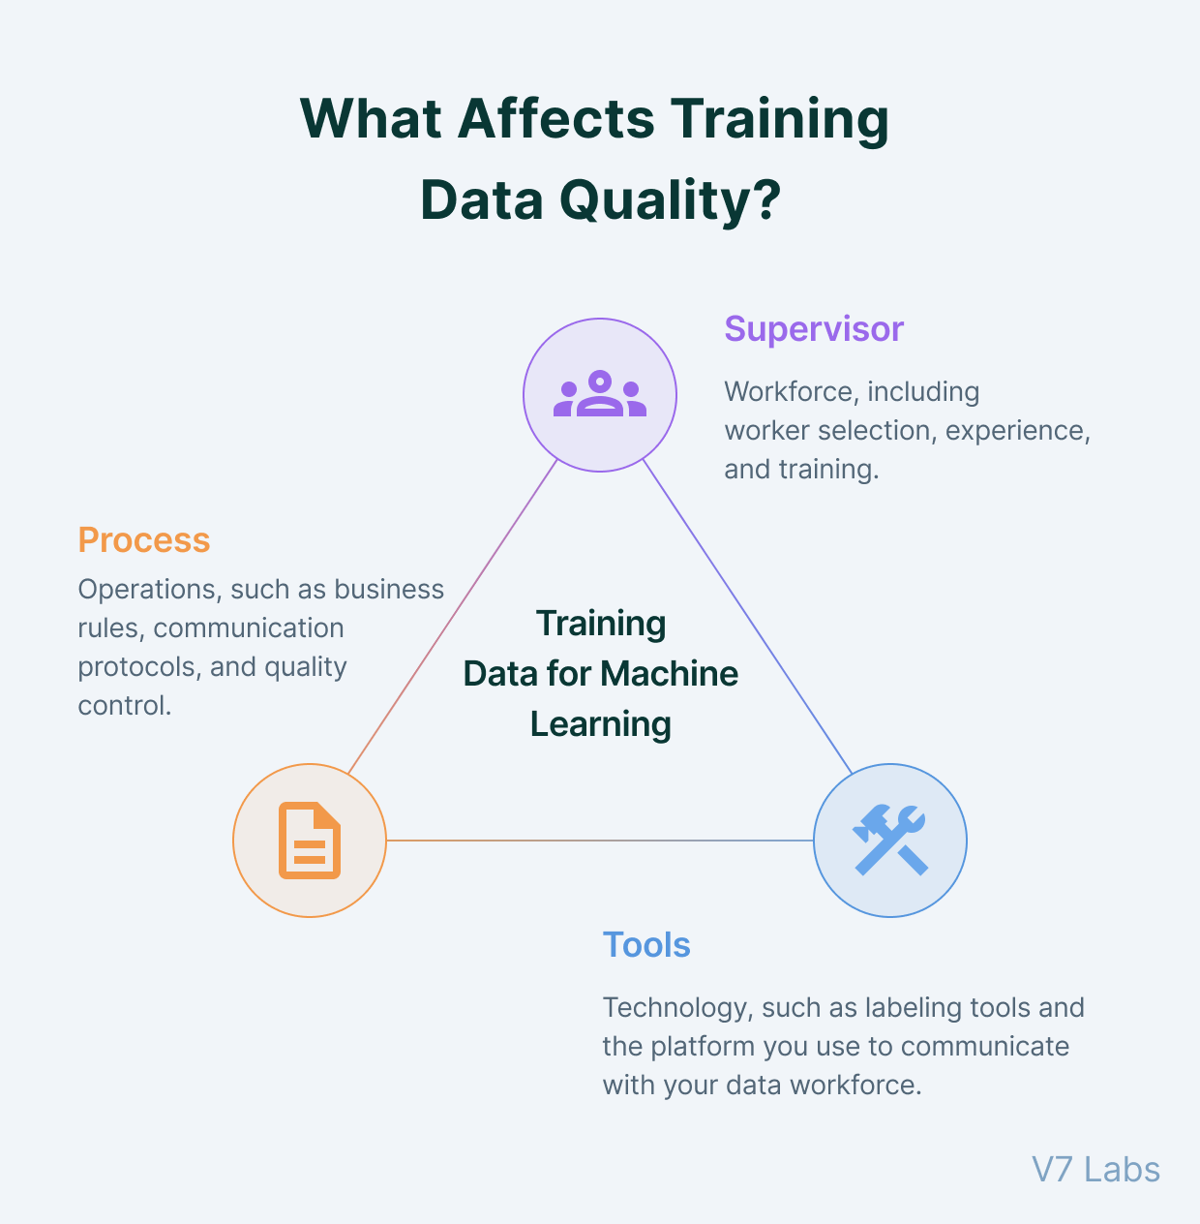
Potential Poor Data Quality
ML quality is often based on the data it learned on
If there isn't enough high-quality data, it will train itself on inaccurate data, further amplifying the problem
This could also give poor recommendations for users
High quality data is essential for a ML algorithm to be successful
Source: IABAC. (n.d.). Issues in machine learning. https://iabac.org/blog/issues-in-machine-learning

Slide 24
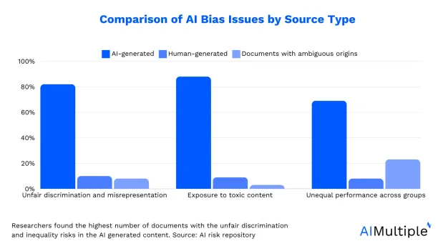
Potential Data Biases
Algorithmic bias is when an algorithm repeatedly makes systematic errors that can lead to unfair outcomes such as pricing or privileging a specific group
Biases in data can also influence the final conclusions/how results are interpreted, making the final result potentially less reliable
Sources: https://www.codecademy.com/article/bias-in-data-analysis
https://research.aimultiple.com/ai-bias/

Slide 25
Data Security for User Recommendations
E-Commerce services often takes user data for personalized recommendations
Protecting this data is crucial to provide security in data privacy
Though AI streamlines the process, human interaction is still essential for successful user recommendations and managing of user data
Source: Data Science Salon. (n.d.). Challenges for AI in eCommerce. https://roundtable.datascience.salon/challenges-for-ai-in-ecommerce

Slide 26
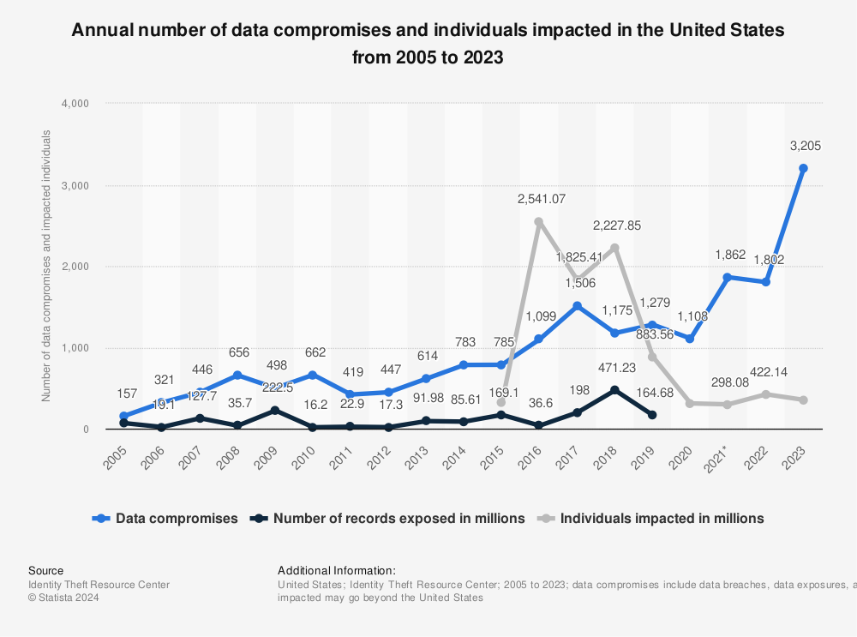

Slide 27
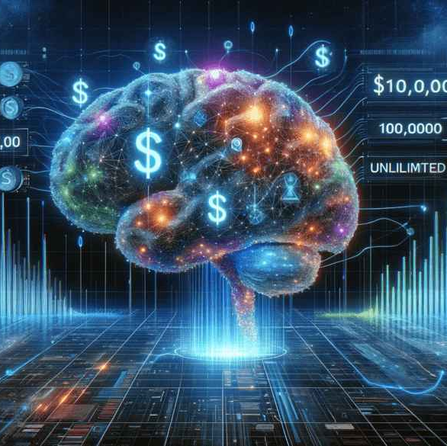
Cost of Implementing ML
Custom AI can cost anywhere from $10,000 - $500,000
The hardware to sustain it at a large scale is expensive as well, since dedicated servers are required
Maintaining and implementing a successful ML system requires highly trained people
Source: EasyFlow. (n.d.). The cost of AI integration for businesses. https://easyflow.tech/businesses-ai-integration-cost/

Slide 28
The Future of ML in E-Commerce

Slide 29
Machine learning is undeniably shaping the future of E-Commerce
Assist companies to be dynamically established (by deep understanding)
Make sustain in the competition (competition information)
Make sustain & visible in technology-driven market (assess technological gap, gain expertise)
Sources:
https://www.aalpha.net/blog/machine-learning-in-ecommerce/ - by: Pawan Pawar, CEO – Aalpha Information Systems India Pvt. Ltd.
https://itrexgroup.com/blog/applications-of-machine-learning-in-ecommerce/ - by: By Yelena Lavrentyeva, Innovation Analyst - Published on June 30, 2023

Slide 30

Questions?

Slide 31
Thank you!
Ahmed Saif – ah557937@dal.ca
Ghazaleh Safaribeidokhti - gh928879@dal.ca
Kazi Alimul Alam – kz731723@dal.ca
Tia Maxfield – vc994177@dal.ca
Saeedeh Salemi – sd702482@dal.ca

